Slide 1
Fantasy Classroom Design Project
Group Members: Dingyi, Mathew, Ikon, Nikhil

Slide 2

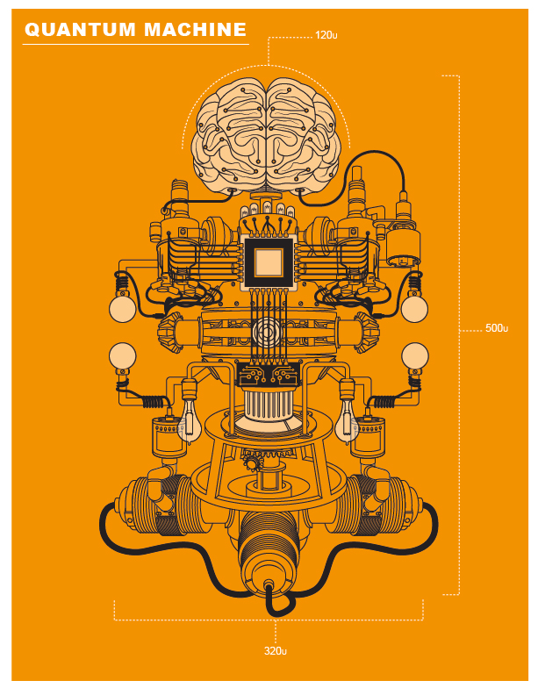
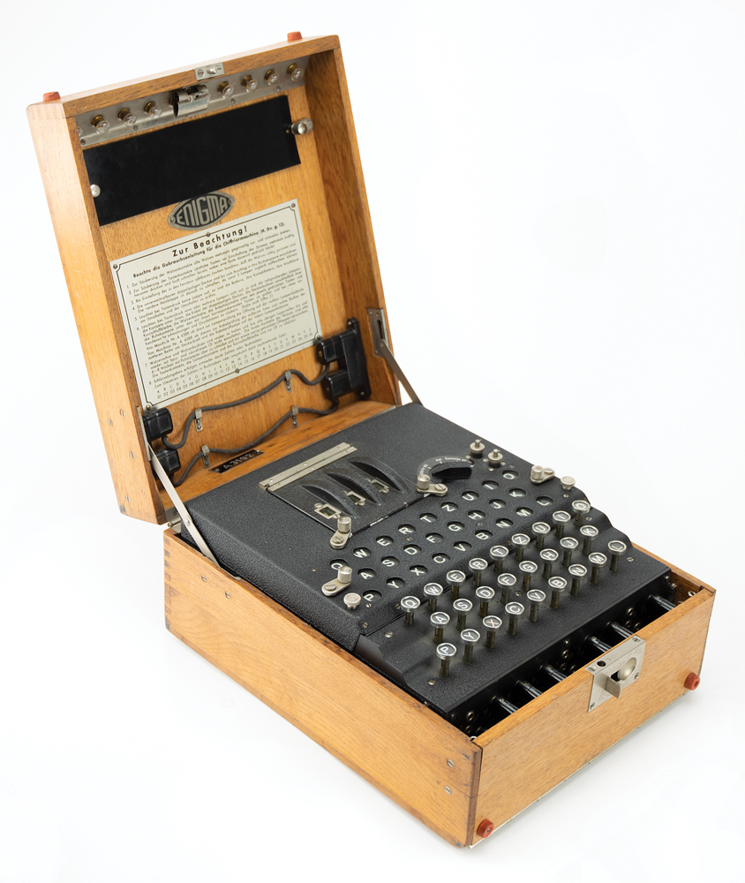
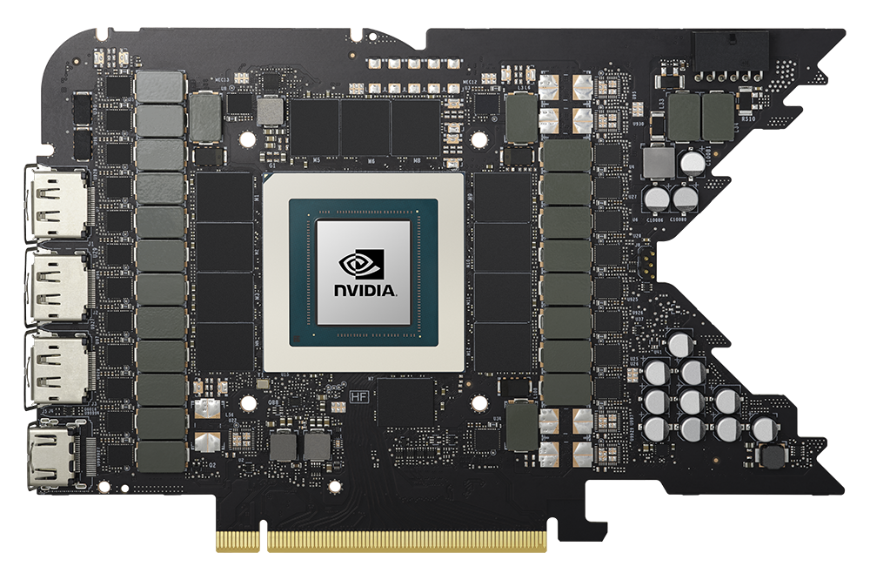
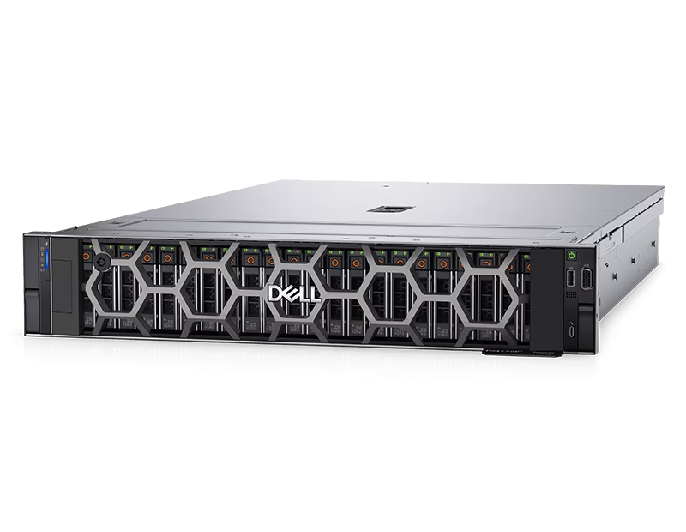
Decorations
Quantum Machine Poster
Enigma Machine
Working Dell storage server
PCB of a 4090 FE
Wellness Poster

Slide 3
Floor Plan
Server Room
Samsung 100 inch OLED TV
Elevated Floor
Teacher Desk
Computer Science Mat
Table
SRC
Ice Cream Van
Table
Table
Computer Station (Provides free Thinkpad P1’s)
Puzzle + Collection

Slide 4
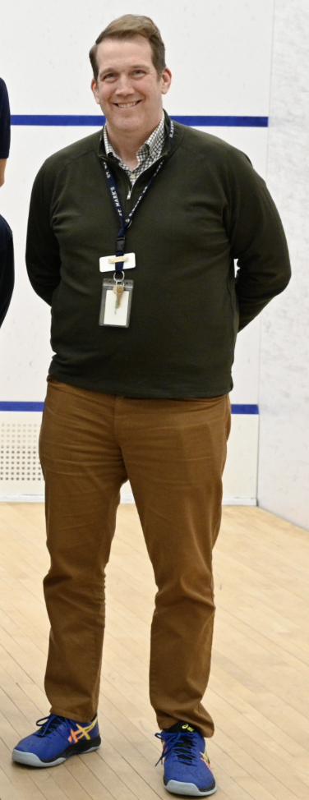
Who is an Ideal Teacher
Ways to take Mr. L presence to another level:
Leadership in the classroom
Connect and engage with the students
Be fun and joyous
Stays in touch even outside of class times
Canvas feedback and email responses are well written/thought
CS
Students
Mr. L

Slide 5
Thank you for watching
Links
4090 FE
Enigma Machine
Dell Storage Server

